Slide 1
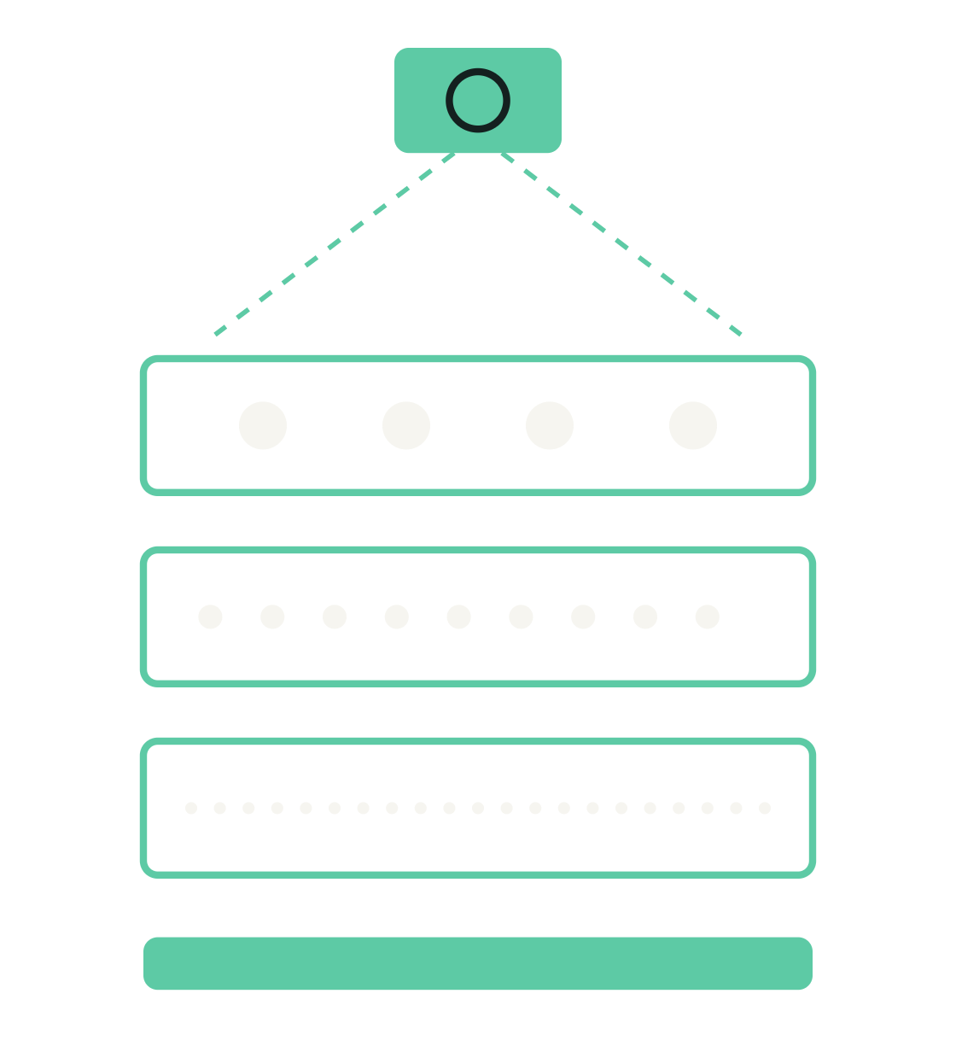
Automated sieving robot
Design intent and results
Camera-guided sorting of mixed samples with a robot arm

Slide 2
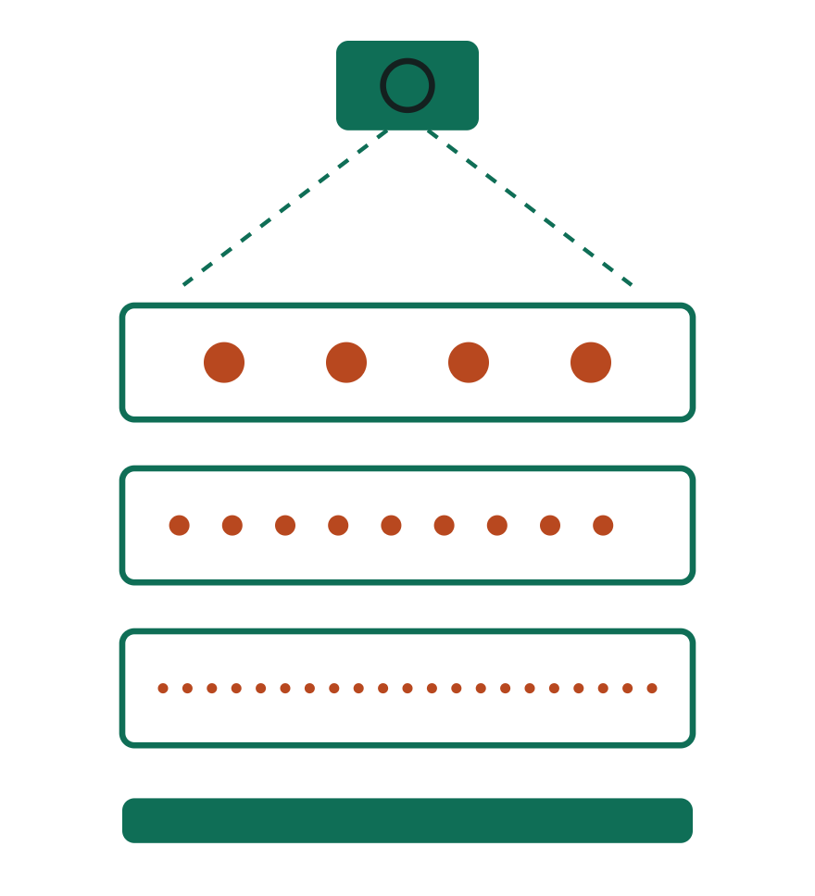
Sort a mixed sample with no manual sieving
Design intent
Camera measures the sample and picks the sieve sizes
Robot arm builds the stack and handles every tray
Loop of shake, image and check until each layer is pure
Clean layers delivered to scientists in collection boxes
Automated sieving robot

Slide 3
Workflow
Design intent
01
02
03
04
Image the sample
Measure size distribution
Choose sieve meshes
Robot stacks trays on rack
05
06
07
08
Shake the rack
Pull tray and re-image
Purity check, repeat if low
Pour into collection boxes
Automated sieving robot

Slide 4
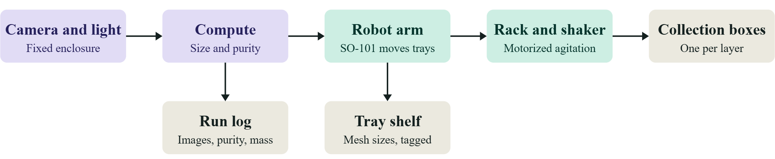
System architecture
Design intent
Automated sieving robot

Slide 5
Deciding when a tray is done
Design intent
Purity per tray
Pass rule
Stop and flag
Target objects divided by all objects in the tray image
At least [target %] on two cycles in a row
[N] cycles max, or no improvement: send to human review
Automated sieving robot

Slide 6
What we achieved
Outcome
[Which parts of the pipeline work end to end]
[Measured purity or accuracy, with sample size]
[Cycle time per sample]
[What was demonstrated live]
Automated sieving robot

Slide 7
What we learned
Outcome
[Biggest technical surprise]
[What limited accuracy: lighting, clumping, occlusion]
[What the arm could and could not handle]
[What we would design differently]
Automated sieving robot

Slide 8
Future work
Outcome
Motorized shaker, with the arm only moving trays
Validate purity against hand-sorted or weighed trays
Load cell for mass balance and loss checks
Train classifier for bugs versus dirt
[Add your own]
Automated sieving robot

Slide 9
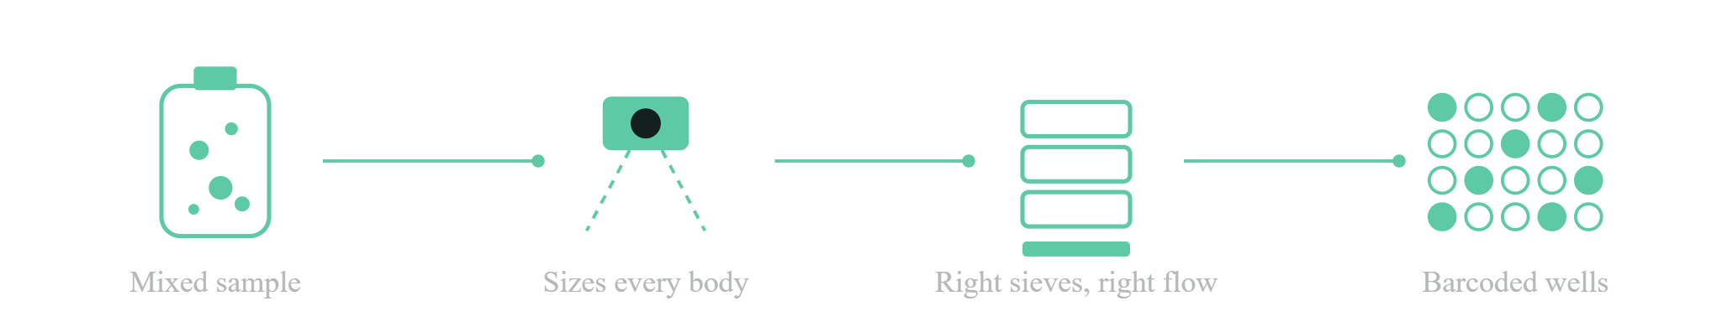
Bags in, barcodes out
Hackathon pitch
Camera-guided insect sieving for BioKEA Track A
Automated sieving robot | Hackathon pitch
Notes:
0:00-0:25. Sample prep is the bottleneck: separating specimens from debris by size, by hand. Our system looks first, then decides which sieves to use. Bags in, barcodes out.

Slide 10
Six steps, each one checked
How it works
01
02
03
04
05
06
Observe
Hypothesize
Preflight
Run
Verify
Hand off
Camera and two sizers measure every body
Pick sieve stack and water flow
Digital twin must pass
Arm places sieves, water rinses
Image each fraction, update margin
Files for BugPicker, then wells
Every step is written to a hash-chained provenance log, per sample
Automated sieving robot | Hackathon pitch
Notes:
0:25-1:05. Six stages: observe, hypothesize, preflight, run, verify, hand off. Teal steps are software, orange steps move hardware. Each step is logged so a result can be traced back to the exact sample and parameters.

Slide 11
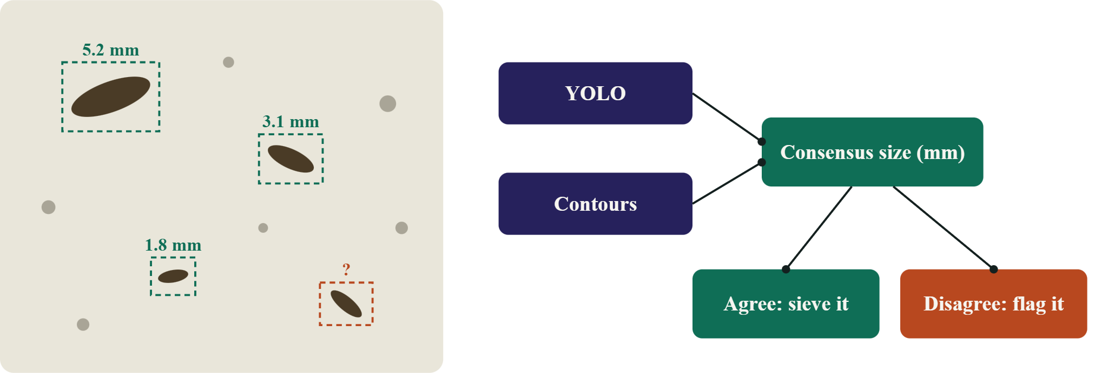
Two sizers must agree
Observe
Automated sieving robot | Hackathon pitch
Notes:
1:05-1:40. A USB camera with a printed scale marker measures every body in millimetres. YOLO and classical contours fail in different ways, so we only act on sizes both agree on. Disagreements are flagged instead of sieved blind.

Slide 12
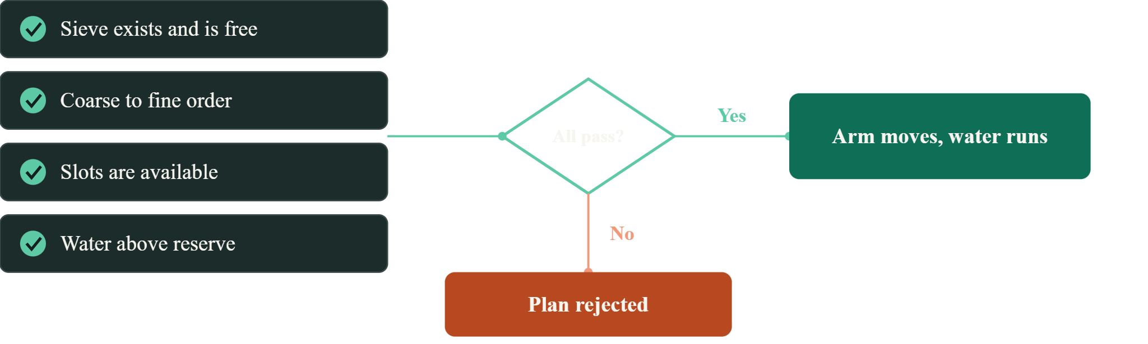
Fail closed before hardware moves
Preflight
Automated sieving robot | Hackathon pitch
Notes:
1:40-2:10. Before anything reaches the arm, a digital twin of the bench checks that the sieve exists and is free, the order is coarse to fine, slots are open and there is enough water. If any check fails, nothing moves.

Slide 13
Built today, next on the bench
Status
Built
Next
Camera sizing in mm, two sizers
Sieve stack and flow planner
Digital twin preflight
Provenance log and MCP server
BugPicker file handoff
Drive the real arm and sieves
Measure real mesh apertures
Train YOLO on bug analogs
Collect real damage data
Ask: [what you need from judges or partners]
Automated sieving robot | Hackathon pitch
Notes:
2:10-3:00. Be honest: the sizing, planning, twin, provenance and handoff are built. Closing the loop on real hardware, measuring real apertures and training on bug analogs are next. Finish with your ask.

